Slide 1
COP4020 – Programming Languages
Elementary and Structured
Data Types

Slide 2
Data types
1. Primitive data types
2. Character Strings
3. User-defined Ordinal Types
4. Array types and Associative Arrays
5. Record Types
6. Union Types
Pointer and Reference Types

Slide 3
Primitive Data Types
Each data object is characterized by a set of attributes:
  Data type - Determines number, types and organization of data values
  Data values
  Permitted operations
Primitive data type - value always manipulated as a unit
  Numeric Types
    Integers
    Floating Point
    Decimal
  Booleans
  Characters

Slide 4
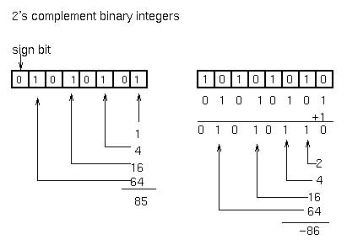
Integer representation format
Integers:
Binary representation In:
  2's complement
  Excess Notation
  Unsigned
For 32-bit words:
Maximum value:
2³¹-1
Minimum value:
-2³¹
Integers in Java
Positive values Negative values

Slide 5
IEEE floating point format
IEEE standard 754 specifies both 32- and 64-bit floating point numbers, comprised of three fields.
32-bit numbers consist of:
  S: a one-bit sign field. 0 is positive.
  E: an exponent in excess-127 notation. Values (8 bits) range from 0 to 255, corresponding to exponents of 2 that range from -127 to 128.
  M: a mantissa of 23 bits. Since the first bit of the mantissa in a normalized number is always 1, it can be omitted and inserted automatically by the hardware, yielding an extra 24th bit of precision.

Slide 6
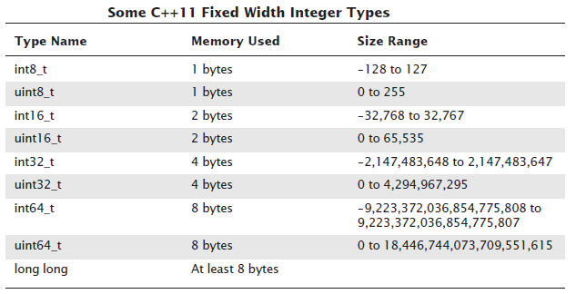
Standardizing Sizes of Integers

Slide 7
C# Integer Sizes
Type | Range | Size
sbyte | -128 to 127 | Signed 8-bit integer
byte | 0 to 255 | Unsigned 8-bit integer
char | U+0000 to U+ffff | Unicode 16-bit character
short | -32,768 to 32,767 | Signed 16-bit integer
ushort | 0 to 65,535 | Unsigned 16-bit integer
int | -2,147,483,648 to 2,147,483,647 | Signed 32-bit integer
uint | 0 to 4,294,967,295 | Unsigned 32-bit integer
long | -9,223,372,036,854,775,808 to 9,223,372,036,854,775,807 | Signed 64-bit integer
ulong | 0 to 18,446,744,073,709,551,615 | Unsigned 64-bit integer

Slide 8
Floating Point Numbers
Floats are approximations of most real values
Floats:
Doubles
8 bits
23 bits
exponent
mantissa
sign bit
range: 10⁻³⁸ to 10³⁸.
11 bits
52 bits
exponent
mantissa
sign bit
range: 10⁻³⁰⁸ to 10³⁰⁸

Slide 9
Demonstrations and Website
\programs\floatDoubleTest.java
Website for floating point numbers

Slide 10
More about primitive data types
Short integers (C) - 16 bit
Long integers (C) - 64 bit
Boolean or logical may be numeric
Byte - 8 bits
Character - Single 8-bit byte - 256 characters . ASCII is a 7 bit 128 character code
In C, a char variable is simply the 8-bit integer numeric representation

Slide 11
Composite data - Strings
Character Strings: data object composed of a sequence of characters
Alternatives pertaining to length of strings:
  1. Fixed Length (Static length):
  Java – strings are immutable
  2. Variable Length with Bound (Limited Dynamic Length):
  DCL D CHAR(20) VARYING - PL/I - 0 to 20 characters
  3. Unbounded Length (Dynamic Length):
  D = “ABC” – javaScript and Perl - dynamically allocated

Slide 12
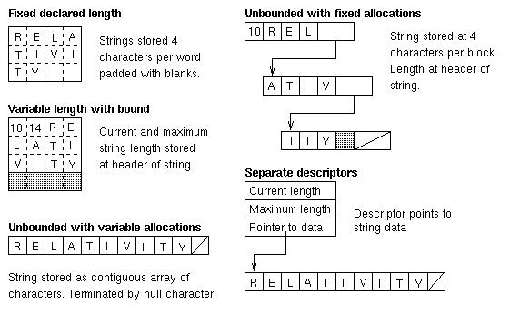
String implementations

Slide 13
User-defined Ordinal Types
Ordinal Types – the range of possible values can be associated with a set of positive integers (they can be ordered)
User-defined Ordinal Types:
  Enumeration Types – all possible values (represented as named constants) are provided. Makes programs self-documenting and secure
  Subrange Types – contiguous subsequence off an ordinal type

Slide 14
Structured data objects
Constructed as an aggregate of other data objects, called components
Components may be elementary data types or other data structures
Important issues:
  Specification and implementation of structural info
  How to select a component?
  Storage management for structured data objects is more complex than for elementary data objects

Slide 15
Structured data object design issues
Major attributes for specifying structured data objects:
Number of components
  Fixed size (some implementations of arrays, records, etc.)
  Variable size (stacks, lists, etc.)
Type of each component
  Homogeneous (arrays, sets, files) or
  heterogeneous (records, lists)
Names used for selecting components
  Subscript (arrays), identifier (record), etc.
Maximum number of components (for variable size)
  Example: maximum stack size
Organization of components
  Linear sequence (vectors, records, stacks)
  multidimensional arrays, aggregate records or lists

Slide 16
Structured data objects
New classes of operations for structured data objects:
Component selection operations
  Random selection (example: subscript selection)
  Sequential selection (example: looping)
Whole-data structure operations
  Examples: addition of two arrays, record assignment, set union
Insertion/deletion of components
  Operations affect storage management
Creation/destruction of data structures
  Also affect storage management

Slide 17
Arrays and Vectors
Vector or one-dimensional array:
  Fixed number of homogenous elements organized as a simple linear sequence
Two-dimensional array or matrix:
  Components organized (logically or conceptually) into a rectangular grid of rows and columns
Array examples:
Pascal: V: array [-5 .. 5] of real;
C: float A[10]; (range 0 – 9)

Slide 18
Arrays – Design Issues
What types are legal for subscripts?
Are subscript expressions range checked?
When are subscript ranges bound?
When does array allocation occur?
Are ragged or rectanglular (or both) multi-dimensional arrays allowed?
Can arrays be initialized when they have storage allocated?
What kinds of slices (if any) are allowed?

Slide 19
Compile-time descriptor for a
One - dimension array
Array
Element type
Index Type
Index Lower Bound
Index Upper Bound
Base Address

Slide 20
Multidimensional arrays
Two-dimensional array: matrix of rows and columns
Three-dimensional array: planes of rows and columns
Multi-dimensional array: generally constructed from arrays of fewer dimensions
Row-major versus column-major order
Pascal example:
M: array [1 .. 3,-1 .. 1] of real;

Slide 21
Array Mapping Functions
For a two-dimensional array, the array mapping function is:
Location(a[i,j]) = address of a[0,0]
+(#rows below the ith row * #items in a row * element size)
+(number of elements left of the jth column)) * element size)

Slide 22
Compile-time descriptor for a
multidimensional array
Multidimensional Array
Element type
Index Type
Number of dimensions
Index range 1
. . .
Index range n
Base Address

Slide 23
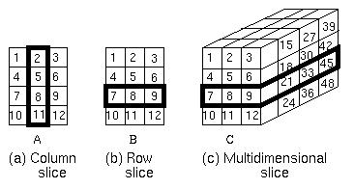
Array Slices
A slice is a substructure of an array that itself is an array.

Slide 24
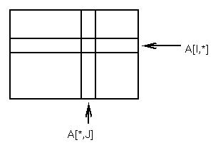
Array Slices
PL/I example:
(a) A(*, 2)
(b) A(3, *)
(c) A(3, *, *)
Also implemented in
FORTRAN 95:
(a) A(1:3, 2)
(b) A(2:3, 1:3)
(c) A(3, 1:3, 1:4)
Comparison of array slices in various languages

Slide 25
Records
A record is a data structure composed of a fixed number of components of different types.
COBOL’s great strength was in its ability to define complex nested records.
In C, C++ and C# records are supported via structs
C++ - structs are a minor variation on classes (struct.cc)
References to data fields are based upon base addresses and offsets.

Slide 26
Accessing elements of Records
myRec->fieldname = . . .;
myRec.fieldname = . . .;
myRec^.fieldname = . . .;

Slide 27
Union Types
Free unions – no type checking
  Equivalence in Fortran (deprecated after 41 years!!)
  C and C++ (\programs\enumerations.h)
Discriminated Unions – each construct has a type indicator called a tag

Slide 28
Type shape is (Circle, Triangle, Rectangle);
Type Colors is (Red, Blue, Green);
Type Figure (Form:Shape) is
record
Filled: Boolean;
Color: Colors;
case Form is
when Circle =>
Diameter: float;
when Triangle =>
LeftSide: Integer;
RightSide: Integer;
Angle: float;
when Rectangle =>
Side1: Integer
Side2: Integer;
end case;
end record;
Ada Example

Slide 29
C/C++ example
union intflo
{
int intnum;
float flonum;
} unex;
printf(“sizeof (union intflo) %d\n”, sizeof(union intflo));
unex.intnum = 734;
printf(“unex.intnum = %d\n”, unex.intnum);
unex.flonum = 8.5;
printf(“unex.flonum = %d\n”, unex.flonum);
Output:
sizeof (union intflo) 4;
unex.intnum = 734;
unex.flonum = 8.5;

Slide 30
Heterogenous node types in a data structure
typedef enum { typeCon, typeId, typeOpr } nodeEnum;
/* constants */
typedef struct {
nodeEnum type; /* type of node */
int value; /* value of constant */
} conNodeType;
/* identifiers */
typedef struct {
nodeEnum type; /* type of node */
char name[50]; /* subscript to ident array */
} idNodeType;

Slide 31
Heterogenous node types in a data structure
/* operators */
typedef struct {
nodeEnum type; /* type of node */
int oper; /* operator */
int nops; /* number of operands */
union nodeTypeTag *op[1]; /* operands */
} oprNodeType;
/* now the union */
typedef union nodeTypeTag {
nodeEnum type; /* type of node */
conNodeType con; /* constants */
idNodeType id; /* identifiers */
oprNodeType opr; /* operators */
} nodeType;

Slide 32
Lists
List
  Ordered sequence of data structures
  Similar to vectors, but not always fixed-length and homogenous
LISP example:
  (FunctionName Data1 Data2 … DataN)
  (cons ‘(a b c) ‘(d e f)) = ((a b c) d e f)
Most LISP operations take list arguments and return list values
Uses linked-list storage management
List variations
  Stacks, queues, trees, directed graphs

Slide 33
Composite data - Pointers
Pointers are used to create arbitrary data structures using:
  Elementary pointer data type (l-value)
  Creation operation for fixed-size data objects
  De-referencing operation to follow pointers
Pointers can point to data objects of a single type (for static type checking languages: C, Pascal, Ada): (ptr.cc)
struct List { int ListValue; List *NextItem; };
struct List *P;
Or to data objects of any type (Smalltalk): type checking done dynamically during execution

Slide 34
Pointers and References
The difference between pointers and references:
  Pointers point to memory locations
  References point to objects
Design issues:
  What is the scope and lifetime of a pointer?
  What is the lifetime of a heap-dynamic variable?
Dereferencing – distinction between the address and its contents:
  int x = 10;
  int * ptr = &x;
dereferencing yields 10

Slide 35
Pointer problems
Dangling Pointers (References) – one problem arising from permitting aliasing
  int * p = &x;
  int * q = p;
  free (p);
Lost Heap-Dynamic Variables – memory leaks, a problem of languages that do not have automatic garbage collection:
  int * p = &x;
  int * q = &y;
  p = q;

Slide 36
Pointer Problems
Many programs have been found to suffer from buffer overflow errors.
Responsible for many network security problems.
A buffer overflow occurs when more data is received than will fit in the buffer. The question is, what happens then?
If the error is detected by the program or by the networking software, the only thing that has happened is a failed network data transmission.
The real problem occurs when the software does not properly detect buffer overflows.
In that case, the software continues to store data in memory even after the buffer is filled, and the extra data goes into some part of memory that was not allocated by the program as part of the buffer.
A buffer overflow might cause part of a program to be replaced with extra data received over a network.
Computer might execute a program that was received from another computer.

Slide 37
Pointer Problems
For software written completely in Java, buffer overflow errors are impossible.
The language does not provide any way to store data into memory that has not been properly allocated.
To do that, you would need a pointer that points to unallocated memory or you would have to refer to an array location that lies outside the range allocated for the array.
Neither of these is possible in Java.
However, there were errors in the Java virtual machine and JDK (as late as Java 5 at least), which was written in the C++ programming language rather than in Java.
C# has "unsafe" mode for pointers – buyer beware ....

Slide 38
Heap Management
Storage management generally is a central concern of programmers, language implementors and language designers.
Storage management may dictate language features.
Examples:
  FORTRAN was always restricted to non-recursive subprogram calls because of static memory allocation and no runtime stack. FORTRAN 90 was an enormous departure.
  Pascal, C, C++, Java and Ada permit programmer control of heap memory allocations but not stack allocations.
  LISP - system uses heap
  LISP and Java implement garbage collection

Slide 39
Programmer Control of the Heap
To what extent should the programmer control storage?
Example:
  C permits malloc and free
  Other high level languages do not require the programmer to take responsibility for direct control of deallocation.
Difficulties of programmer control – places an undesirable burden on the programmer – dangerous.
    Garbage
    Dangling References
Advantages
  It can be difficult for the system to determine when storage may most efficiently be allocated and freed.
  Programmer knows when to allocate, when to free memory

Slide 40
Heap-based Storage
Heap - area of storage within which memory units can be allocated and deallocated by the programmer.
Fixed or variable sized blocks may be allocated. Memory must be managed in such a way as to prevent heap fragmentation.
  Utilizes a Free space list
  Simpler for fixed size blocks
Memory may be managed by
  Explicit programmer control
  Reference counts
  Garbage collection

Slide 41
Explicit Recovery
Explicit return by programmer
  Garbage - free “too late”
  Dangling references - free “too soon”
Alternative Approaches to explicit recovery:
  Reference Counts
  Garbage Collection

Slide 42
Reference Counts
Reference counts - Each element in the heap has a reference counter indicating the number of pointers to that element.
When an element is initially allocated its rc = 1.
When an additional pointer is set to the item, rc is incremented
When a free is executed, rc is decremented
Reference Counts are Expensive:
Example: P = Q;
1. Access the element P points to, decrement rc
2. if rc = 0, then return element to freespace list
3.Copy l-value of Q into P
4.Access element Q points to, increment rc.

Slide 43
Garbage Collection
Allow garbage to accumulate to avoid dangling references.
When the freespace list is exhausted - identify garbage elements in the heap and return them to the free-space list.
Two phases of garbage collection:
  Mark - Each element has a garbage collection bit set to “on.” The mark process sets the bit off for those elements that are still active.
  Sweep - sequential scan of the heap putting those elements with the reclaim bit set on back into the free-space list.
Mark is the more difficult - an element is active if there is a pointer to it from outside the heap. Two part process for marking:
  Start outside and identify all elements pointed to from outside the heap.
  Scan the elements in the heap for pointers to other elements.

Slide 44
Garbage Collection Algorithms
Interleaved with program execution:
  Reference Counting
Tracing Algorithms:
  Mark and Sweep
  Copy Collection
  Mark and Compact
Heuristic Approach:
  Generational Garbage Collectors

Slide 45
Reference Counting
Concept:
  Used to keep track of whether objects are in use by counting the number of references pointing to them.
  An additional field, called the reference count, is associated with each memory object.
  When the object is referenced with a new pointer, the reference count is incremented.
  When a pointer goes out of scope or attempts to deallocate, the RC is decremented.
  When (RC == 0), the object may be deallocated.
Advantages
  Object management is active
  Collection is interleaved with the execution of the application, not all-at-once
Disadvantages
  Additional space is required to keep the reference count
  The counter must be updated every time there is a change in the references to an object.
  Cannot reclaim cyclic structures, such as (but not limited to) doubly linked lists, cyclic graphs, etc.

Slide 46
Mark-and-Sweep Garbage Collection
The mark and sweep algorithm is a type of tracing garbage collector.
Phases:
Mark - identifies all active objects by globally traversing all live objects. The trace starts with the objects that are currently reachable from the program:
  all object references from global variables
  references from variables in the runtime stack.
Each visited object is ‘marked’ as ‘live’, and the objects it references are visited recursively.
Sweep - all the objects that have not been marked will be claimed as free space.
Execution of the program is resumed.
Advantages
  Cyclic references are handled
  Does not incur overhead when doing pointer manipulation.
Disadvantages:
  Start/stop algorithm: the user program needs to be stopped before the garbage collector starts
  The performance of tracing garbage collectors tends to decrease as the percentage of heap utilization increases.
  Mark-and-sweep collectors tend to fragment memory

Slide 47
Copy Collectors
Another type of tracing garbage collector.
This approach divides the heap into two equally sized semi-spaces for:
  current data
  obsolete data
The Process:
  Flip the roles of the two semi-spaces.
  Traverse the objects in the old semi-space, (Fromspace)
  Copy the live objects into the new semi-space, (Tospace).
  Resume application execution
Advantages
  Compacts the heap every time the collector runs.
  Compaction allows efficient allocation of new objects
  No overhead in pointer manipulation
Disadvantages
The requirement for two semi-spaces.

Slide 48
Mark-and-Compact Garbage Collection
The mark-and-compact algorithm combines the mark-and-sweep and copying algorithms
Phases:
  First phase, each object is visited and live ones are marked.
  Second phase, marked objects are copied so that all the live objects end up together at the bottom of the heap.
Advantages:
  The effect is similar to that of a copy collector, including the allocation performance benefits.
  Long lived objects will accumulate at the bottom of the heap, so they will not be repeatedly copied as in the case of the copying collector.
Disadvantage:
  As in all trace algorithms, substantial time is spent repeatedly tracing persistent objects

Slide 49
Generational Garbage Collection
Concept:
  Storage reclamation can be made more efficient by concentrating efforts on reclaiming objects more likely to be garbage.
  Divide the objects by age into two or more regions of the heap called generations.
  Different generations can be collected at different frequencies
    The ‘youngest’ generation being collected more frequently
    The ‘older’ generations less often.
Collecting a smaller part of the heap decreases pause times, and if the pause times are reduced enough, the garbage collection times will not stop programs from being highly responsive.
This is particularly of interest for real-time and highly interactive programs.
Issues:
  Deciding when to move an object between generations
  Establishing a correct measure for the ‘age’ of an object
  Inter-generational references
  Deciding on the number of generations.

Slide 50
Garbage Collection Summary
  Garbage collection algorithms are advanced enough to make GC a suitable option in modern programming languages
  GC has been implemented in Lisp, Scheme, Python, Ruby, Perl, Modula-2, Smalltalk, Flash (ActionScript) and JavaScript, among others.
  GC creates runtime overhead
  GC also provides some advantages such as faster object allocation times and avoiding fragmentation of the heap.
  The software development process is generally improved if some sort of garbage collection technology is used
    The interaction between modules of the applications will be simpler
    Avoids the problems that manual memory allocation/deallocation might create.

Slide 51
Garbage Collection/Reference Counting Links
Boehm GC for C and C++
Reference Counting
Automatic Reference Counting

Slide 52
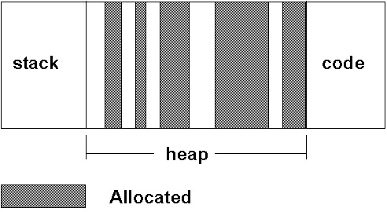
Heap Fragmentation
After allocating and deallocating many blocks of memory, the heap becomes fragmented:

Slide 53
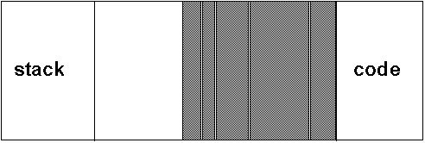
Heap Fragmentation
The need is to defragment the heap by compacting the heap:

Slide 54
Heap Defragmentation
The heap is a storage repository for variable-sized elements which complicates defragmentation.
Algorithms such as first fit or best fit will lead to successively smaller unused blocks.
At some point a request to allocate n contiguous blocks cannot be honored despite the fact that many more than n blocks total are on the free list.
Defragmentation can take either of two forms depending on whether or not active blocks can be shifted in position:
  Partial compaction – if active blocks cannot be shifted, then only adjacent blocks on the free space list may be compacted
  Full compaction – If active blocks can be shifted, then all active blocks can be shifted to one end of the heap leaving a single block of contiguous free memory. All pointers must be modified to point to the new locations.

Slide 55
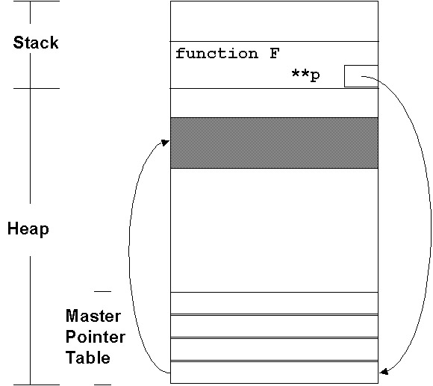
Full Compaction
Full compaction requires that all pointers to a block of memory be updated to reflect the new location of the item when it is moved.
One approach - only have one pointer to anything in the heap (“Handles”)

Slide 56
Example
A code segment from a Macintosh program that uses this scheme for heap management.
tempPt.h = thisPt.h +(**AMap).origin.h;
tempPt.v = thisPt.v +(**AMap).origin.v;
InBackRect = PtInRect(tempPt,& (**AMap).BackRect);
if (InBackRect)
{
BackupExplainEvent();
return;
}

Slide 57
Type Checking
Type checking is the activity of ensuring that the operands of an operator are of compatible types.
Types are compatible if they are the same or if type conversions are allowed under the rules of the language.
Type conversions:
  Implicit
  Explicit
Type checking may be static or dynamic

Slide 58
Strong Typing
First definition:
  A language is strongly typed if:
    Each name has a single type associated with it
    That type is known at compile time
A better definition:
  A language is strongly typed if type errors are always detected
By this criterion:
  Ada is almost strongly typed (explicit type casts are a loophole)
  C/C++ - unions are not type-checked
  Java/C# - like Ada

Slide 59
Type Compatibility
For primitive data types equality is at the bit-level:
int x; int y; OR
float x; float y;
x=y // if they have same bit values
User-defined types raise other issues:
type rational = record
numerator: real;
denominator: real;
end;
var A, B: rational;
if (A = B) then ... ⇐ When is this true?
There is no way for the compiler to understand that rational means the usual mathematical concept of rational numbers.
Equality for user types must be defined by the user.

Slide 60
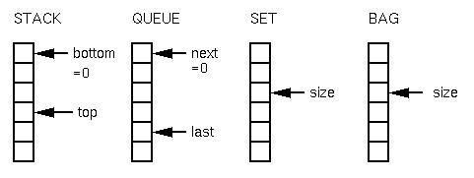
Why a need for separate definition of equality
Consider the following 4 data types and their representations:
All can be defined as:
struct storageList
{
int size;
int storage[100];
};

Slide 61
Meaning of A = B
What does A = B mean for each data type?
  Stack equality:
  A.size = B.size (assuming size represents top of stack)
  For all i, A.storage[i] = B.storage[i]
  Set equality:
  A.size = B.size (assuming size represents number in set)
  For all i, some j, A.storage[i]=B.storage[j]
  (i.e., A.storage is a permutation of B.storage, since set order is not relevant)
So equality of complex data objects cannot be built into the operator by the language definition (effectively).

Slide 62
Equivalence of data types
Are X and Y the same type?
type A = ...; type B = ...; A X; B Y;
Name equivalence: X and Y are name equivalent if they are defined using the same name identifier:
  In Pascal:
  var X: array [1..10] of integer;
  Y: array [1..10] of integer;
  are not name equivalent, but:
  type arr = array [1..10] of integer;
  var U: arr; V: arr;
  are name equivalent.
Structural equivalence: X and Y have the same storage representation:
  x: record
  a: real; b: integer end
  y: record
  m: real; n: integer end
  x and y have structural equivalence

